Slide 1

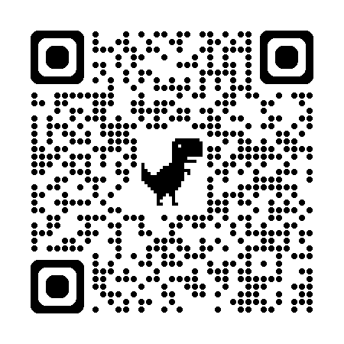

自然語言處理與應用 Natural Language Processing and Applications
Retrieval-Augmented Generation (RAG)
Instructor: 林英嘉 (Ying-Jia Lin)
2025/05/19
Course GitHub
Slido # NLP_0519

Slide 2
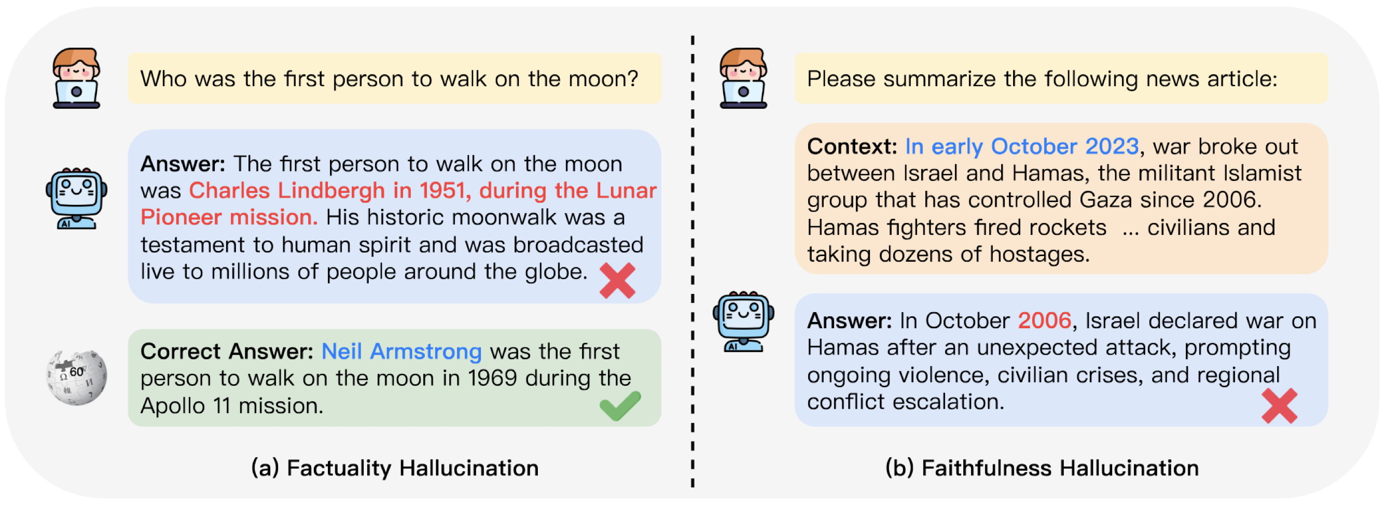
Hallucination of LLM
It is discovered that NLG models often generate text that is nonsensical, or unfaithful to the provided input. Such undesirable generation is referred to Hallucination (Ji et al., 2023).
Ji et al. "Survey of hallucination in natural language generation." ACM Computing Surveys 55.12 (2023): 1-38.
Figure source: Munkhdalai, Tsendsuren, Manaal Faruqui, and Siddharth Gopal. "Leave no context behind: Efficient infinite context transformers with infini-attention." arXiv preprint arXiv:2404.07143 (2024).

Slide 3
Solutions to Mitigating Hallucinations
Chain-of-Thought Prompting (CoT)
Retrieval-Augmented Generation (RAG)
…

Slide 4

Chain-of-Thought Prompting (CoT)
Wei et al., Chain-of-Thought Prompting Elicits Reasoning in Large Language Models. NeurIPS 2022. By Google Brain.
Prompt: Few-shot examples (Rationales written by human)
Question: Sammy wanted to go to where the people were. Where might he go? Answer Choices: (a) populated areas (b) race track (c) desert (d) apartment (e) roadblock
xN
Answer: The answer must be a place with a lot of people. Of the above choices, only populated areas have a lot of people. So the answer is (a) populated areas.
Similar in task
+
A gentleman is carrying equipment for golf, what is he likely to have?
Answer Choices: (a) populated areas (b) race track (c) desert (d) apartment (e) roadblock
Answer: (a) club.
Rationale
Answer
Answer: The answer must be something that is used for golf. Of the above choices, only clubs are used for golf. So the answer is (a) club.

Slide 5
Retrieval-Augmented Generation (RAG)

Slide 6


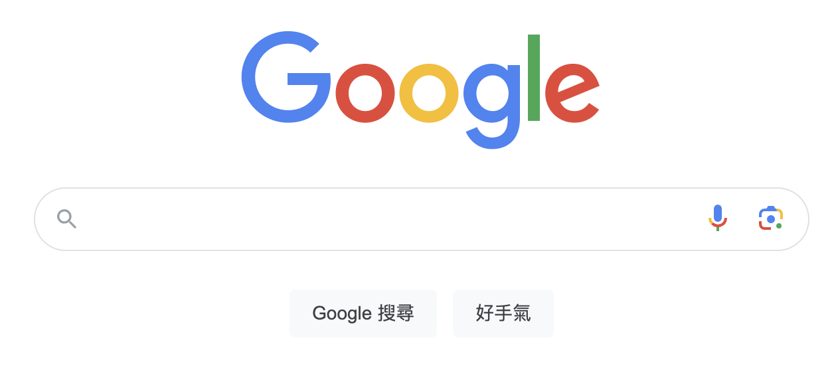
Information Retrieval
Retrieval: get relevant information from a pool (like a search engine)
Retrieval-Augmented Generation (RAG): Perform generation with additional retrieved information

Slide 7


Retrieval-Augmented Generation (RAG)
Input Query
Generator
(e.g., LLM)
LLM Output
Which year was Oppenheimer born?
1967 (Without RAG)
1904 (With RAG)
Retriever
(e.g., BERT)
Robert Oppenheimer (born April 22, 1904, New York, New York, U.S.—died February 18, 1967, Princeton, New Jersey) was an American theoretical physicist and science administrator ...
Retrieved Documents
Knowledge Base (e.g., Wikipedia)
Gao, Yunfan, et al. "Retrieval-augmented generation for large language models: A survey." arXiv preprint arXiv:2312.10997 (2023).

Slide 8
Why do we need RAG?
LLMs have profound parameterized knowledge that makes them useful in responding to general prompts.
However, LLMs are error-prone due to lack of domain knowledge or outdated information.
Standalone LLMs do not serve users who want a deeper dive into a current or more specific topic.
https://blogs.nvidia.com/blog/what-is-retrieval-augmented-generation/

Slide 9
Retrievers for RAG
A retriever is aimed at searching relevant documents based on an input query.
A retriever plays an important role for enhancing performance of an LLM. Therefore, a good retriever is needed.
Usually, a retriever produces outputs by computing similarities between query embeddings and document embeddings, which comes from other encoder models or the retriever itself..

Slide 10
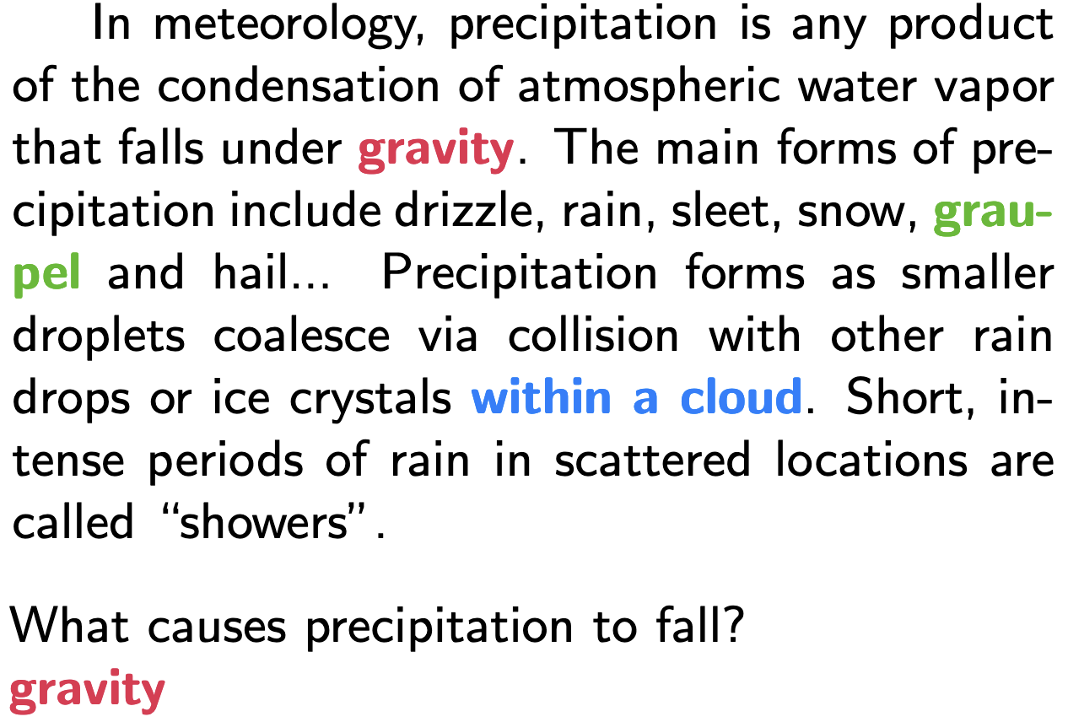
Task: Open-domain question answering (ODQA)
Given a question x such as “What is the currency of the UK?”, a model must output the correct answer string y, “pound”.
The “open” part of ODQA refers to the fact that the model does not receive a pre-identified document that is known to contain the answer.
ODQA is like Reading comprehension (RC) tasks, such as SQuAD, but no relevant articles provided.
(Example of SQuAD)
Guu, Kelvin, et al. "Retrieval augmented language model pre-training." ICML 2020.
Rajpurkar, P., Zhang, J., Lopyrev, K., & Liang, P. (2016). SQuAD: 100,000+ Questions for Machine Comprehension of Text. EMNLP 2016.

Slide 11
Retrievers for RAG
Task-oriented training:
Retrieval for open-domain question answering (ODQA)
Usually used in RAG because it is more common to search relevant documents.
Sentence embeddings for semantic similarity tasks
Retrieval for open-domain question answering
Finding a relevant document
Query
(a question)
Relevant doc
Irrelevant doc
...
Irrelevant doc
Model
搜尋規模較大
500萬篇
Sentence embeddings for semantic similarity tasks
Finding a semantically similar sentence
Sentence
Relevant
Sentence
Irrelevant sentence
...
Irrelevant sentence
Model
20 sentences
Both approaches are suitable for retrieval (depends on your task for an LLM).

Slide 12
Vectors (embeddings) in this semester
Word Embeddings
One-hot Encodings / PMI / LSA (week 2)
Word2vec / GloVe (week 3)
Document Embeddings
Retriever
Bag-of-words / TF-IDF (week 2)
DPR / ... (week 14)
Sentence
Embeddings
Retriever
BERT (week 7)
Sentence-BERT / SimCSE ... (week 14)

Slide 13
Retrieval-Augmented Generation (RAG)
Input Query
Generator
(e.g., LLM)
LLM Output
Which year was Oppenheimer born?
1967 (Without RAG)
1904 (With RAG)
Retriever
(e.g., BERT)
⬅️ 今天重點
Robert Oppenheimer (born April 22, 1904, New York, New York, U.S.—died February 18, 1967, Princeton, New Jersey) was an American theoretical physicist and science administrator ...
Retrieved Documents
Knowledge Base (e.g., Wikipedia)
Gao, Yunfan, et al. "Retrieval-augmented generation for large language models: A survey." arXiv preprint arXiv:2312.10997 (2023).

Slide 14
Sentence embeddings for semantic similarity tasks

Slide 15
BERT as a Cross Encoder
For a cross encoder, representations of two input sentences are attended with each other.
The hidden state of [CLS] represents the relationship between the two input sentences.
H_{[CLS]}
H₁
...
H_{N}
H_{[SEP]}
H’₁
...
H’_{N}
H’_{[SEP]}
BERT
[CLS]
Tok1
...
TokN
[SEP]
Tok1’
...
TokN’
[SEP]
Sentence A
Sentence B
Devlin, J., Chang, M.W., Lee, K., & Toutanova, K. (2019). BERT: Pre-training of Deep Bidirectional Transformers for Language Understanding. NAACL 2019.

Slide 16
Cross-encoder 速度問題
10,000 個句子 ⬇️
Classification
Cross encoder
頭痛可能的原因
Sent1
[SEP]
Sent2
[SEP]
For 10,000 sentence pairs:
Cross encoders: n·(n−1)/2 = 49,995,000 inference times

Slide 17
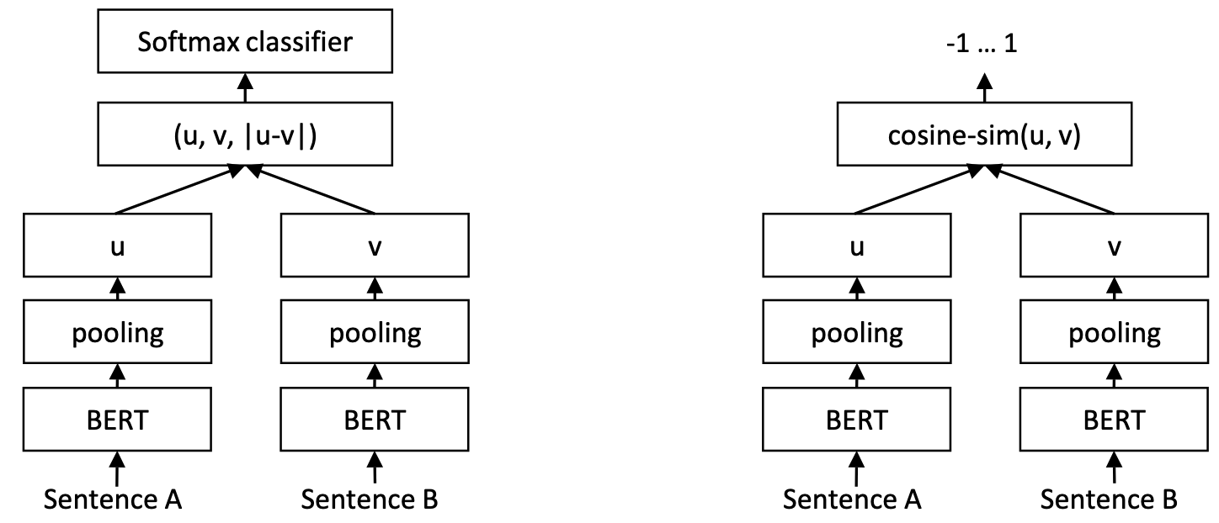
Sentence-BERT
# Pseudo code for Bi-encoder
query_vector = encoder(query) # [0.1, 0.2, 0.3]
document_vector = encoder(document) # [0.2, 0.2, 0.4]
similarity = cosine_similarity(query_vector, document_vector)
Siamese Network
(weights shared)
Training time
Inference time
Reimers, N., & Gurevych, I. (2019). Sentence-BERT: Sentence Embeddings using Siamese BERT-Networks. (EMNLP-ĲCNLP 2019)

Slide 18
Why does Sentence-BERT need pooling?
BERT produces embeddings (hidden states from the final layer) for each token.
We need a single fixed-size vector for the entire sentence.
Output hidden states of input1
Output hidden states of input2
H_{[CLS]}
H₁
...
H_{N}
H_{[SEP]}
H_{[CLS]}
H₁
...
H_{N}
H_{[SEP]}
BERT
BERT
[CLS]
Tok1
...
TokN
[SEP]
[CLS]
Tok1
...
TokN
[SEP]

Slide 19
Pooling of Sentence-BERT
We need a single fixed-size vector for the entire sentence.
CLS: Use the [CLS] token
This is the default setting in original BERT.
MEAN: the mean of all output vectors
Averages all token embeddings.
MAX: max-over-time of the output vectors
Takes maximum value across each dimension.
Reimers, N., & Gurevych, I. (2019). Sentence-BERT: Sentence Embeddings using Siamese BERT-Networks. (EMNLP-ĲCNLP 2019)

Slide 20
Sentence-BERT (Bi-encoder)
Output
Concatenation with element-wise difference
Training time
Inference time
Reimers, N., & Gurevych, I. (2019). Sentence-BERT: Sentence Embeddings using Siamese BERT-Networks. (EMNLP-ĲCNLP 2019)

Slide 21
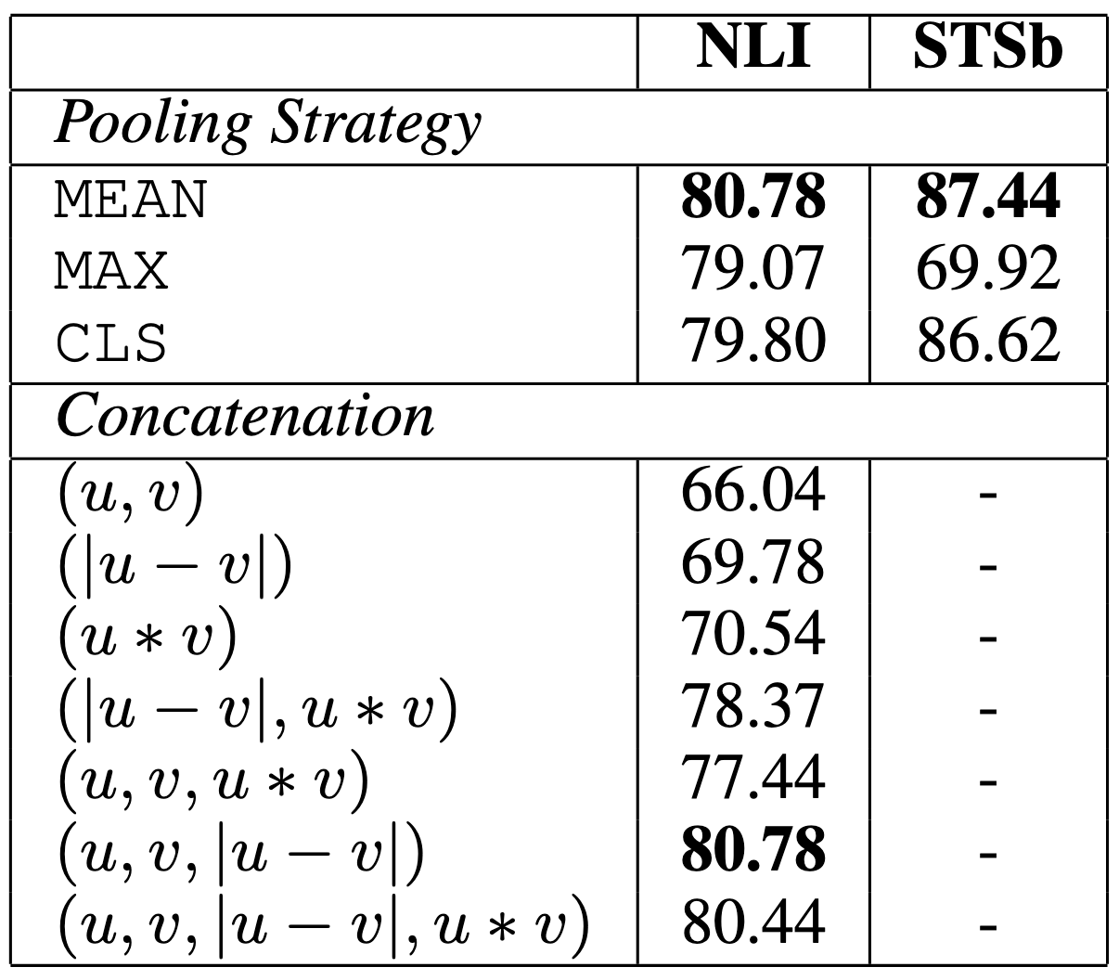
Performance comparison of Pooling and Concatenation
Indeed, [CLS] token can directly be used for representing the entire sentence.
But pooling may bring better performance.
Experiment shows using element-wise difference is better than the other settings.
Note that the concatenation mode is only used for training.
Reimers, N., & Gurevych, I. (2019). Sentence-BERT: Sentence Embeddings using Siamese BERT-Networks. (EMNLP-ĲCNLP 2019)

Slide 22
Computation time for Bi-encoders and Cross encoders
For 10,000 sentence pairs:
Cross encoders: n·(n−1)/2 = 49,995,000 inference times
Bi-encoders: 10,000 * 2 inference times (can be parallel) with cosine similarity calculation
Cosine similarity
Classification
H1
H2
Cross encoder
Encoder
Encoder
Sent1
[SEP]
Sent2
[SEP]
Sent1
Sent2

Slide 23
SimCSE (Bi-encoder)
SimCSE: a simple contrastive sentence embedding framework
Both unsupervised and supervised training approaches were proposed in SimCSE:
Unsupervised training of SimCSE
Relying on Dropout
Supervised training of SimCSE
Relying on labels in a dataset
Gao, Tianyu, Xingcheng Yao, and Danqi Chen. "SimCSE: Simple Contrastive Learning of Sentence Embeddings." EMNLP 2021.

Slide 24
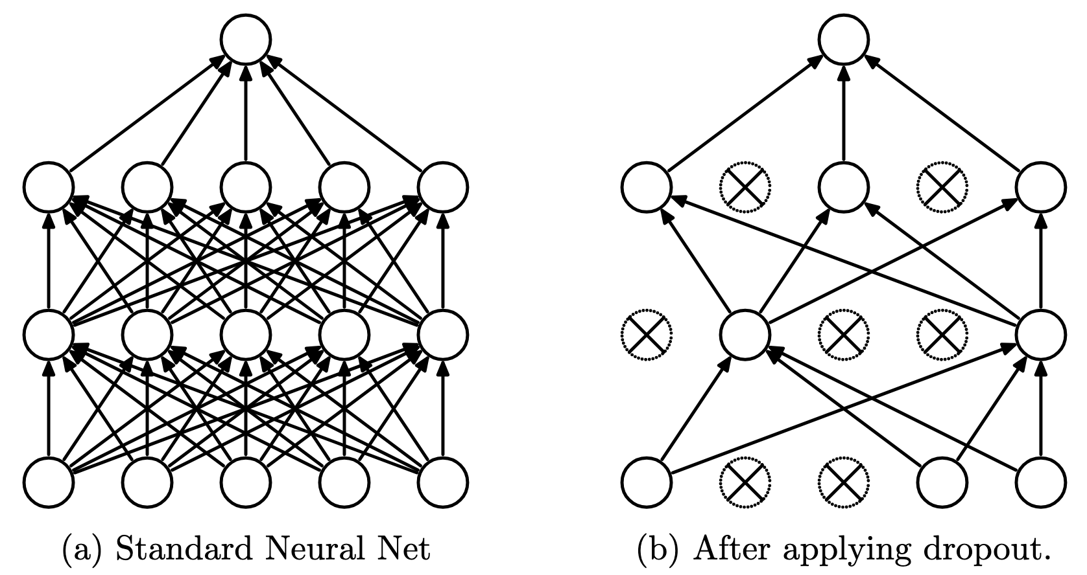
Dropout
Dropout randomly drop units (along with their connections) from the neural network during training. This approach usually brings regularization and reduces overfitting.
Srivastava, Nitish, et al. "Dropout: a simple way to prevent neural networks from overfitting." The journal of machine learning research 15.1 (2014): 1929-1958.

Slide 25
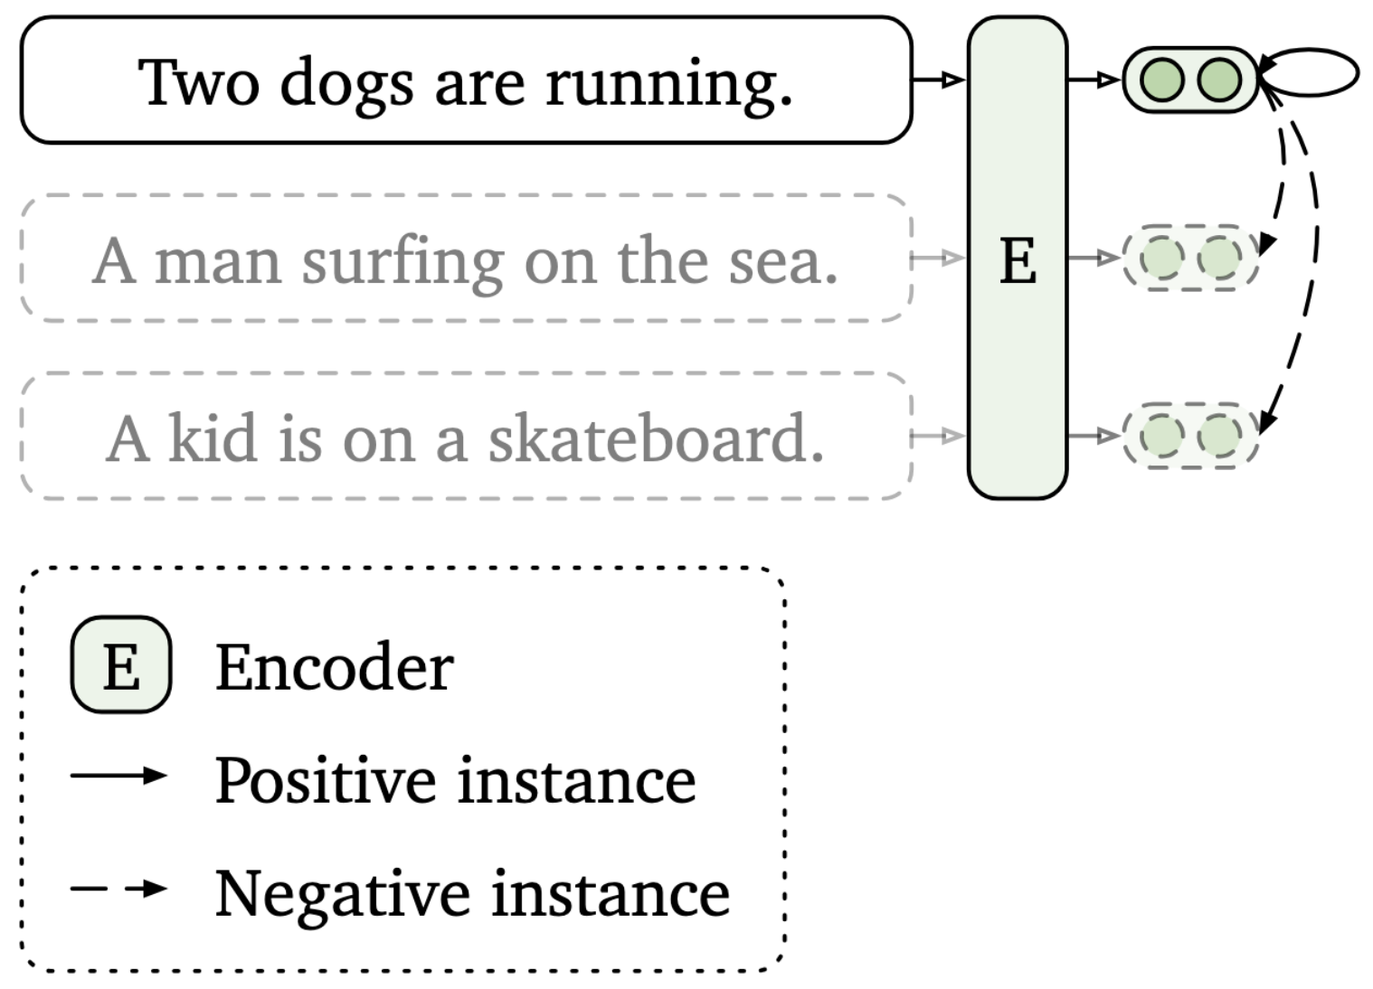
Unsupervised training of SimCSE
Input a sentence twice with a dropout mask
(Dropout as data augmentation)
close
repellent
Output1
Output1’
Output2
SimCSE
SimCSE
SimCSE
Sent1
Sent1
Sent2
Gao, Tianyu, Xingcheng Yao, and Danqi Chen. "SimCSE: Simple Contrastive Learning of Sentence Embeddings." EMNLP 2021.

Slide 26
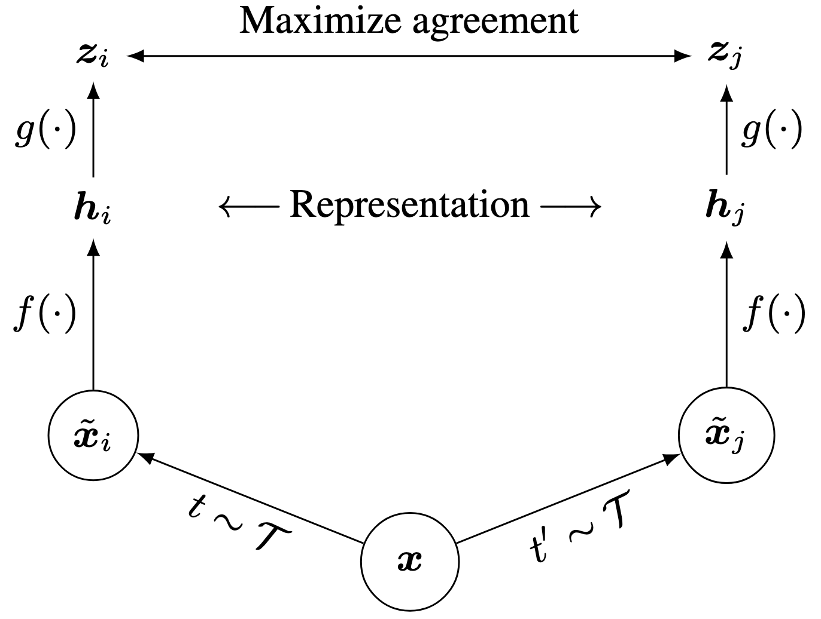
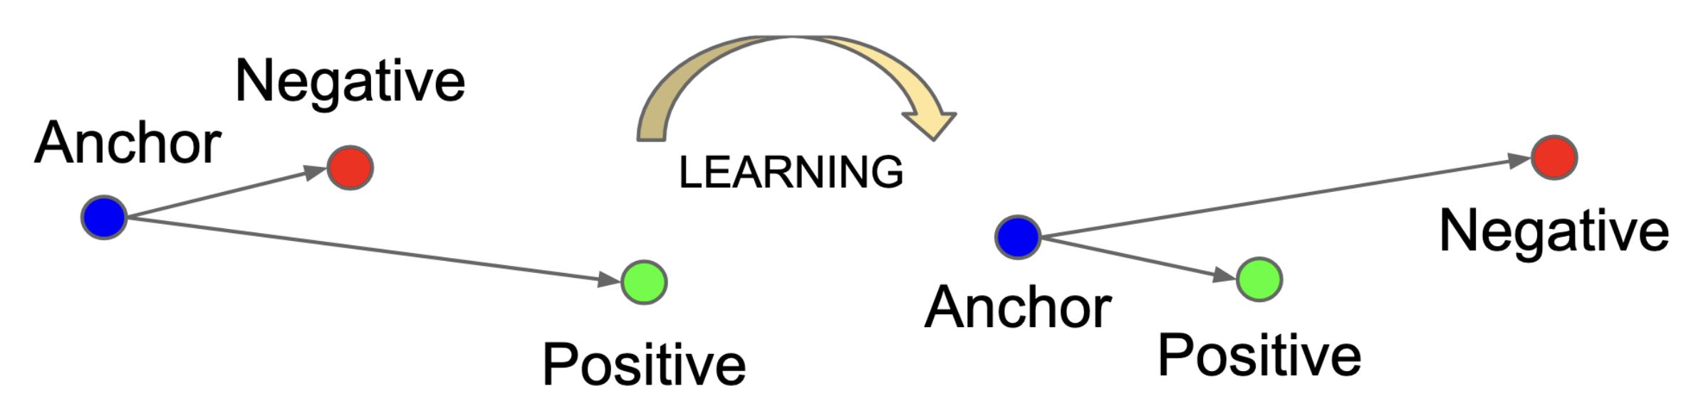
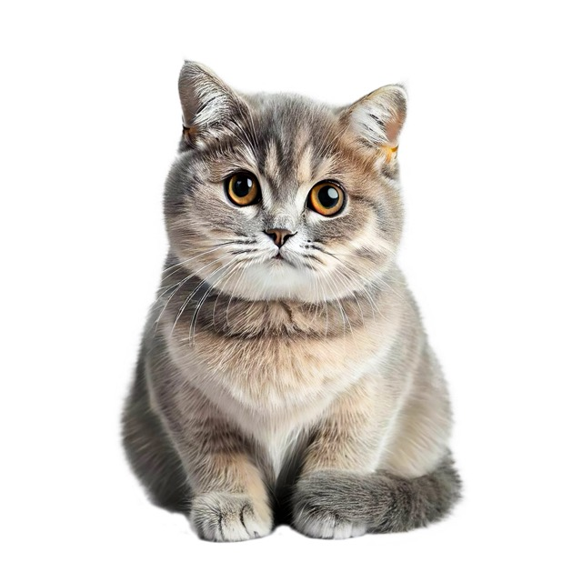
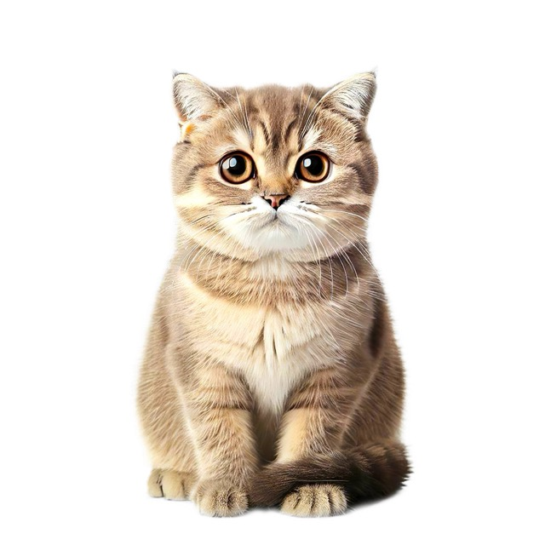
Contrastive Learning in Images
f (·): encoder network
g(·): projection head
z: output logits
The concept of contrastive learning is to maximize the agreement of positive pairs ^{[1][2]} .
A model will be able to learn the connections among similar data and dissimilar data.
Positive pairs
[1] Left Figure source: Schroff, Florian, Dmitry Kalenichenko, and James Philbin. "Facenet: A unified embedding for face recognition and clustering." CVPR 2015.
[2] Right Figure source: Chen, Ting, et al. "A simple framework for contrastive learning of visual representations." ICLR 2020.

Slide 27
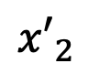
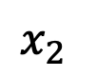
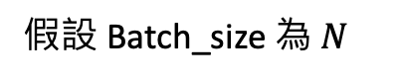
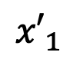
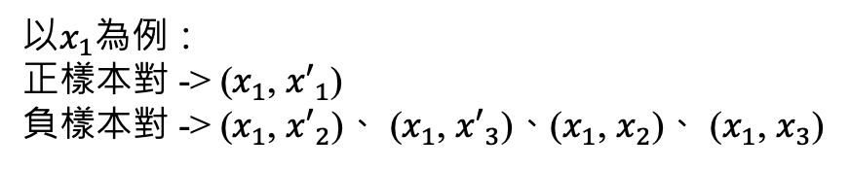
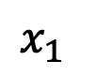
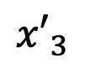
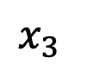
Contrastive Learning Loss (1)
DA: data augmentation
假設 Batch_size 為$N$
Batch
Batch (DA)
$$x_{1}$$
$${x′}_{1}$$
$$x_{2}$$
$${x′}_{2}$$
$$x_{3}$$
$${x′}_{3}$$
Positive pairs
以$x_{1}$為例：
正樣本對 -> ($x_{1}$, ${x′}_{1}$)
負樣本對 -> ($x_{1}$, ${x′}_{2}$)、 ($x_{1}$, ${x′}_{3}$)、($x_{1}$, $x_{2}$)、 ($x_{1}$, $x_{3}$)
Chen, Ting, et al. "A simple framework for contrastive learning of visual representations." ICLR 2020.

Slide 28
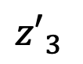
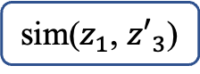
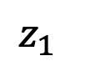
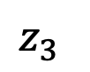
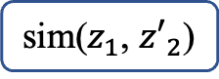
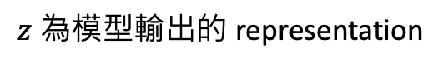
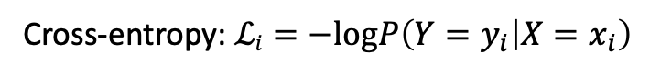
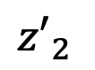

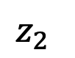
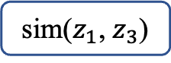
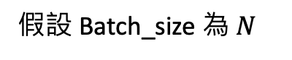
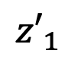
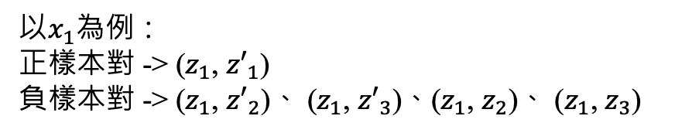

Contrastive Learning Loss (2)
$z$為模型輸出的 representation
假設 Batch_size 為$N$
Batch
Batch (DA)
取 Softmax 後之機率
正確答案
$$z_{1}$$
$${z′}_{1}$$
sim($z_{1}$, ${z′}_{1}$)
0.3
1
$$z_{2}$$
$${z′}_{2}$$
sim($z_{1}$, ${z′}_{2}$)
0.2
0
$$z_{3}$$
$${z′}_{3}$$
sim($z_{1}$, ${z′}_{3}$)
0.1
0
Cross-entropy
sim($z_{1}$, $z_{2}$)
0.1
0
以$x_{1}$為例：
正樣本對 -> ($z_{1}$, ${z′}_{1}$)
負樣本對 -> ($z_{1}$, ${z′}_{2}$)、 ($z_{1}$, ${z′}_{3}$)、($z_{1}$, $z_{2}$)、 ($z_{1}$, $z_{3}$)
sim($z_{1}$, $z_{3}$)
0.3
0
相當於在做 2N-1 個類別之分類任務
Chen, Ting, et al. "A simple framework for contrastive learning of visual representations." ICLR 2020.
Cross-entropy: $ℒi=−logP\left(Y=y_{i} | X=x_{i}\right)$

Slide 29
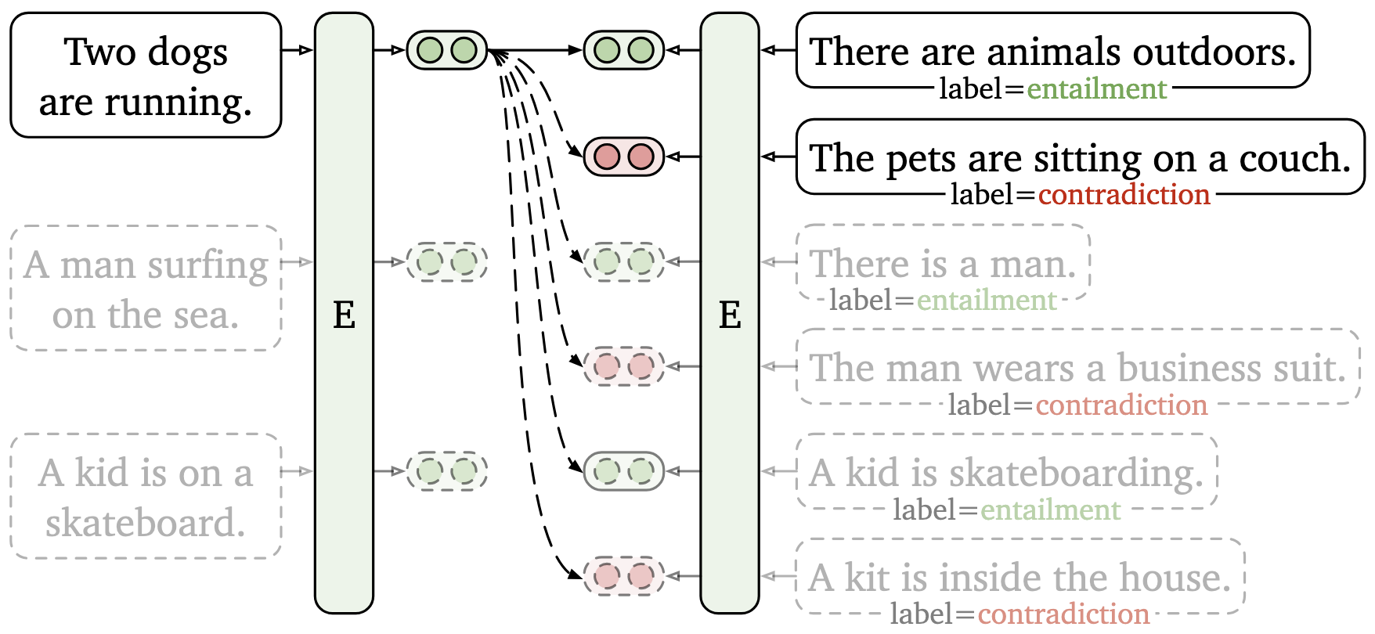
Supervised training of SimCSE
Supervised training of SimCSE relies on labels in a dataset to define positives and negatives.
Gao, Tianyu, Xingcheng Yao, and Danqi Chen. "SimCSE: Simple Contrastive Learning of Sentence Embeddings." EMNLP 2021.

Slide 30
Retrieval for open-domain question answering (ODQA)

Slide 31
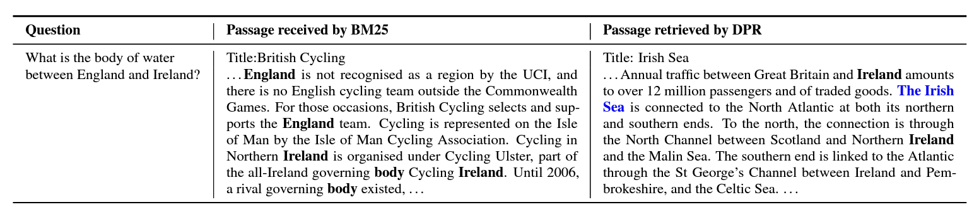
Dense Passage Retrieval (DPR)
Dense retrieval focuses on semantic similarity
Passages and questions are embedded into dense vectors
Dense vectors enable better matching for related words or phrases (e.g., “the body of water” matched with “sea”)
Karpukhin et al., 2020. Dense Passage Retrieval for Open-Domain Question Answering. EMNLP 2020.
Retrieval-Augmented Generation

Slide 32
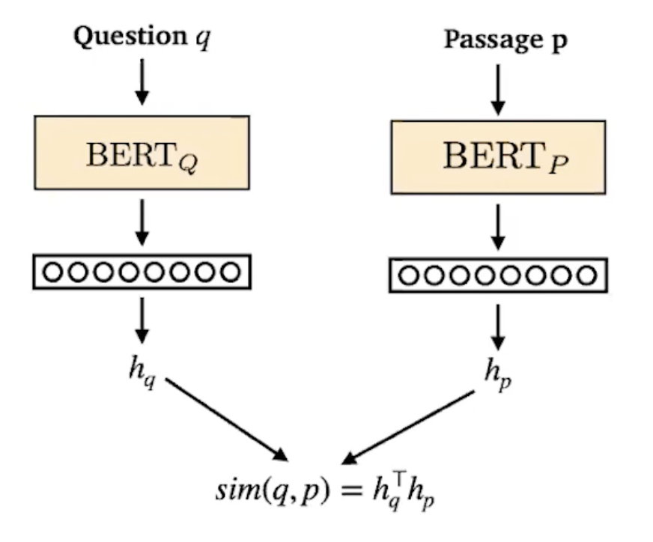
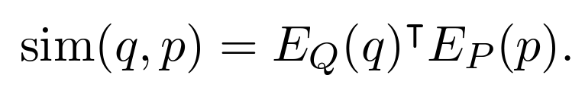
Dense Passage Retrieval (DPR)
After training, two BERT-based encoders can independently encode question (q) and passage (p) into dense vectors.
Similarity between question and passage
= dot product between their embeddings
q : question text
p : passage text
E_{Q} : BERT model that outputs question representation
E_{p} : BERT model that outputs passage representation
Image source: Stanford CS224N Lecture 12 - Question Answering
Karpukhin et al., 2020. Dense Passage Retrieval for Open-Domain Question Answering. EMNLP 2020.
Retrieval-Augmented Generation

Slide 33
Dense Passage Retrieval (DPR)
Training the encoders
Goal: Relevant pairs of questions and passages will have smaller distance than the irrelevant ones
Training data
m training instances
Question
Relevant Passage
n Irrelevant Passages
Karpukhin et al., 2020. Dense Passage Retrieval for Open-Domain Question Answering. EMNLP 2020.

Slide 34
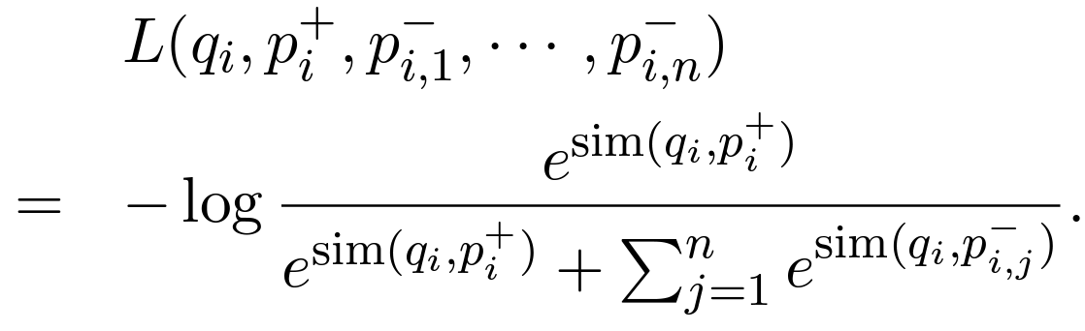
Dense Passage Retrieval (DPR)
Training the encoders
Base model: bert-base-uncased
Loss function: Negative log-likelihood of the positive passage
Maximize the similarity between q_{i} and p_{i}⁺
Minimize the similarity between non-relevant pairs (q_{i} and p_{i,j}⁻ )
Karpukhin et al., 2020. Dense Passage Retrieval for Open-Domain Question Answering. EMNLP 2020.

Slide 35
Summary Parameter Sharing
 | BERT (Devlin et al., NAACL 2019) | Sentence-BERT (Reimers et al., EMNLP 2019) | SimCSE (Gao et al., EMNLP 2021) | DPR (Karpukhin et al., EMNLP 2020)
Encoder Type | Cross-encoder | Bi-encoder | Bi-encoder | Dual encoder
Weight Sharing | Nan | Yes | Yes | No (Separate Query Encoder and Passage Encoder)

Slide 36
Complete RAG

Slide 37
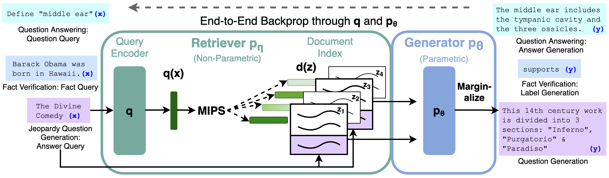
Retrieval-Augmented Generation (RAG)
This approach is the first RAG paper.
No pre-training is involved. Only fine-tuning on open-domain QA.
MIPS: Maximum Inner-Product Search (speed-up approach, supported by indexing packages like FAISS.)
Lewis, Patrick, et al. "Retrieval-augmented generation for knowledge-intensive nlp tasks." NeurIPS 2020.

Slide 38
Challenges in Modern RAG
A significant amount of noise information even fake news in the content available on the Internet.
Currently, there is a lack of comprehensive understanding of how each model can improve performance through information retrieval.

Slide 39
Type of Noises
Relevant (semantically similar) but not contain the answer
Counterfactual information
Irrelevant information
…

Slide 40
Capabilities that LLMs Should Have in RAG
Noise Robustness
LLMs must be able to extract the necessary information from documents despite there are noisy documents.
External documents contain noises
Retrieval Augmented Generation
Question
The Nobel Prize in Literature for 2022 is awarded to the French author Annie Ernaux, “for the courage and clinical acuity …
Who was awarded the 2022 Nobel prize in literature?
Annie Ernaux
The Nobel Prize in Literature for 2021 is awarded to the novelist Abdulrazak Gurnah, born in Zanzibar and active in …

Slide 41
Capabilities that LLMs Should Have in RAG
Noise Rejection
In real-world situations, the search engine often fails to retrieve documents containing the answers.
It is important for the model to have the capability to reject recognition and avoid generating misleading content.
External documents contain noises
Retrieval Augmented Generation
Question
The Nobel Prize in Literature for 2021 is awarded to the novelist Abdulrazak Gurnah, born in Zanzibar and active in …
Who was awarded the 2022 Nobel prize in literature?
I can not answer the question because of the insufficient information in documents.
The 2020 Nobel Laureate in Literature, poet Louise Glück, has written both poetry and essays about poetry. Since her…

Slide 42
Capabilities that LLMs Should Have in RAG
Information Integration
In many cases, the answer to a question may be contained in multiple documents.
To provide better answers to complex questions, it is necessary for LLMs to have the ability to integrate information.
External documents contain noises
Retrieval Augmented Generation
Question
On May 18th, 2023, OpenAI introduced its own ChatGPT app for iOS…
When were the ChatGPT app for iOS and ChatGPT api launched?
May 18 and March 1.
That changed on March 1, when OpenAI announced the release of API access to ChatGPT and Whisper,…

Slide 43
Query Rewriting
Motivation:
There is inevitably a gap between the input text and the knowledge that is really needed to query.
Gap between a query and docs in a database
Elia Kazan was an American film and theatre director, producer, screenwriter and actor, described ......
Input query
What profession does Nicholas Ray and Elia Kazan have in common?
Retriever
Nicholas Ray American author and
director, original name Raymond
Nicholas Kienzle, born August 7,
1911, Galesville, Wisconsin, U.S......
Ma, Xinbei, et al. "Query Rewriting in Retrieval-Augmented Large Language Models." EMNLP 2023.

Slide 44
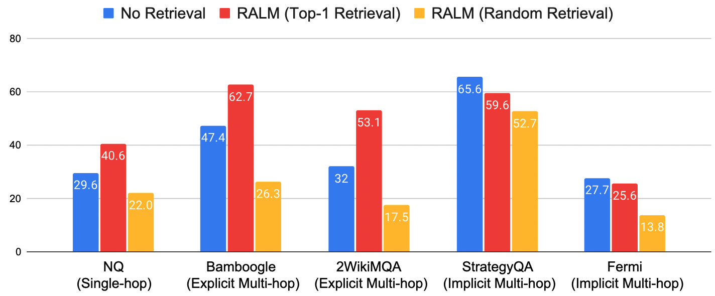
RetRobust: Making Retrieval-Augmented Language Models Robust to Irrelevant Context
Retrieval augmentation can boost performance, but it also hurts performance on StrategyQA and Fermi, and random contexts reduce performance dramatically.
Yoran, Ori, et al. "Making Retrieval-Augmented Language Models Robust to Irrelevant Context." ICLR 2024.

Slide 45
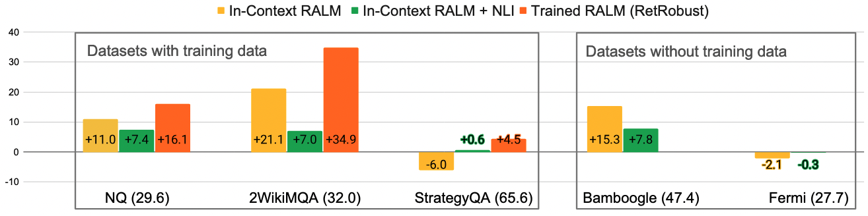
RetRobust: Making Retrieval-Augmented Language Models Robust to Irrelevant Context
Train the generator on QA tasks with both relevant and irrelevant retrieved documents.
Relevant documents
Generator
(e.g., LLM)
Queries
Retriever
Irrelevant documents
(fixed)
Yoran, Ori, et al. "Making Retrieval-Augmented Language Models Robust to Irrelevant Context." ICLR 2024.

Slide 46
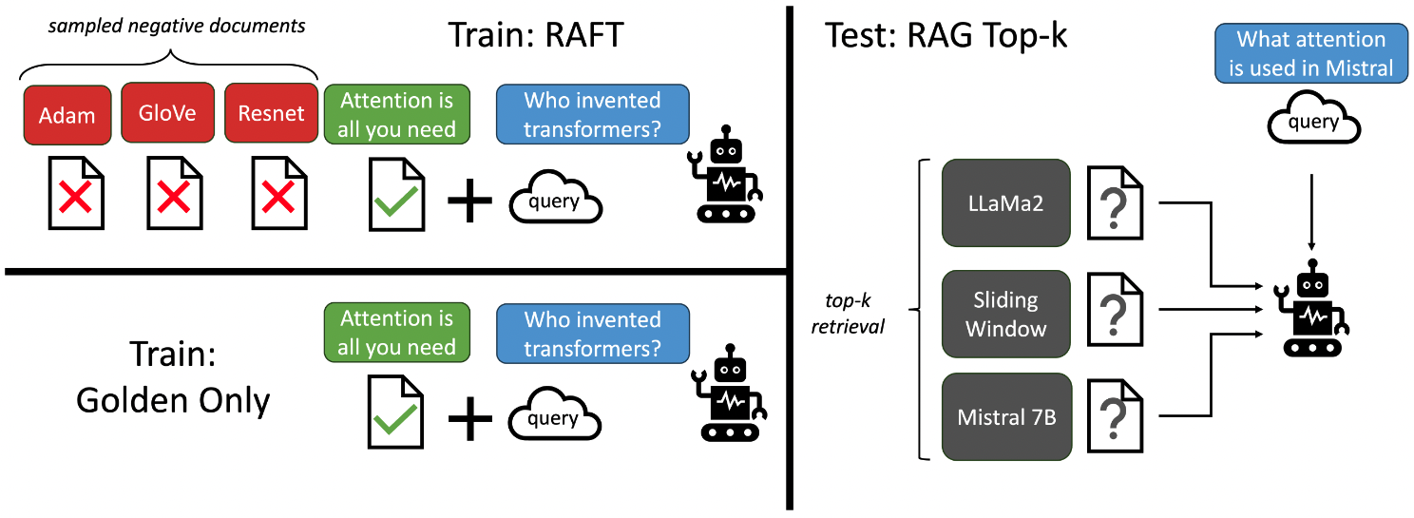
RAFT: Adapting LLM to RAG
In this work, the retriever is fixed. An LLM is trainable.
Both correct and incorrect documents are included during training.
MateiZaharia, TianjunZhang ShishirG Patil NamanJain ShengShen, and IonStoica JosephE Gonzalez. "RAFT: Adapting Language Model to Domain Specific RAG.” COLM 2024.

Slide 47
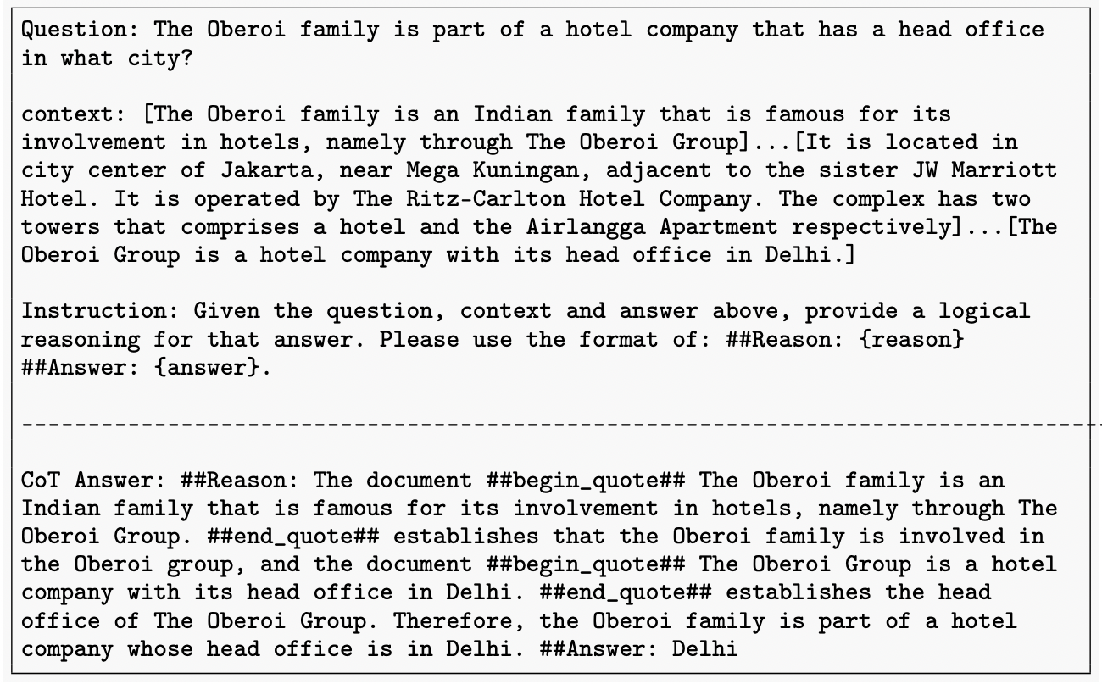
Difference between RetRobust and RAFT
Context 包含錯誤資訊
RAFT uses CoT Answer (answer with rationales).
MateiZaharia, TianjunZhang ShishirG Patil NamanJain ShengShen, and IonStoica JosephE Gonzalez. "RAFT: Adapting Language Model to Domain Specific RAG.” COLM 2024.

Slide 48
Capabilities that LLMs Should Have in RAG
Counterfactual Robustness
In the real world, there is an abundance of false information on the internet.
LLMs should identify risks of known factual errors in the retrieved documents when the LLMs are given warnings about potential risks in the retrieved information through instruction.
External documents contain noises
Retrieval Augmented Generation
Question
The 2004 Olympic Games returned home to New York,
birthplace of the …
Which city hosted the Olympic games in 2004?
There are factual errors in the provided documents. The answer should be Athens.
After leading all voting rounds, New York easily defeated Rome in the fifth and final vote …

Slide 49
Other Techniques for Boosting RAG Performance

Slide 50
Query Rewriting
Ma, Xinbei, et al. "Query Rewriting in Retrieval-Augmented Large Language Models." EMNLP 2023.
Motivation:
There is inevitably a gap between the input text and the knowledge that is really needed to query.
Elia Kazan was an American film and theatre director, producer, screenwriter and actor, described ......
Input query
What profession does Nicholas Ray and Elia Kazan have in common?
Retriever
Nicholas Ray American author and
director, original name Raymond
Nicholas Kienzle, born August 7,
1911, Galesville, Wisconsin, U.S......
Nicholas Ray profession
Elia Kazan profession

Slide 51
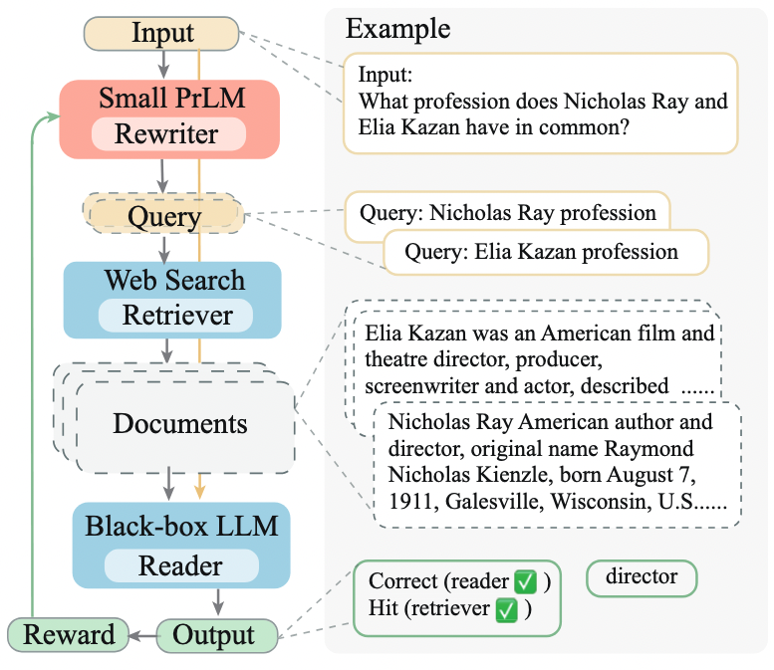
Query Rewriting – Approach
Ma, Xinbei, et al. "Query Rewriting in Retrieval-Augmented Large Language Models." EMNLP 2023.

Slide 52
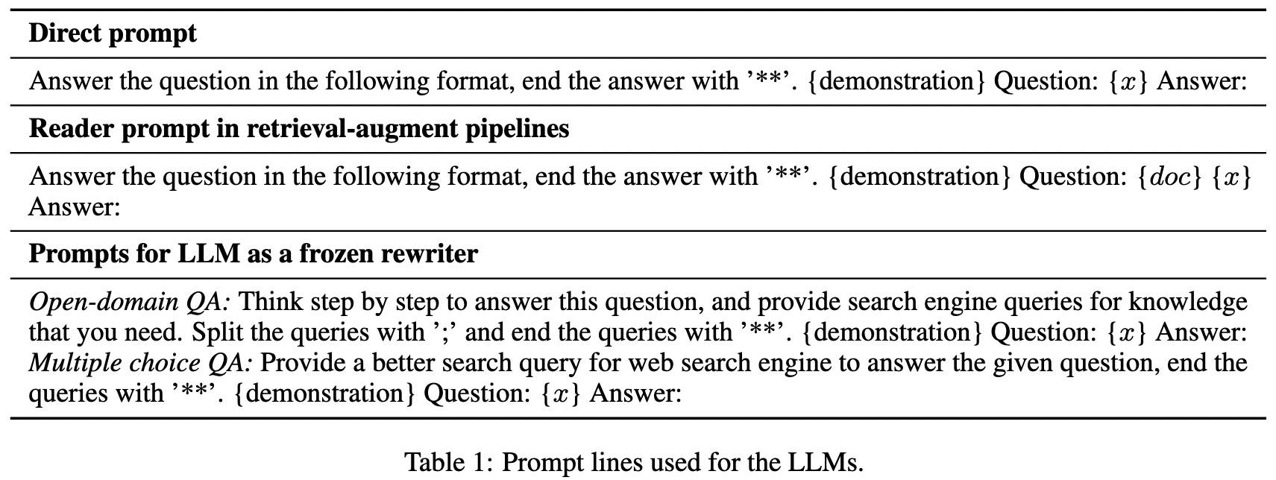
Query Rewriting – Prompt for the LLMs
Ma, Xinbei, et al. "Query Rewriting in Retrieval-Augmented Large Language Models." EMNLP 2023.

Slide 53
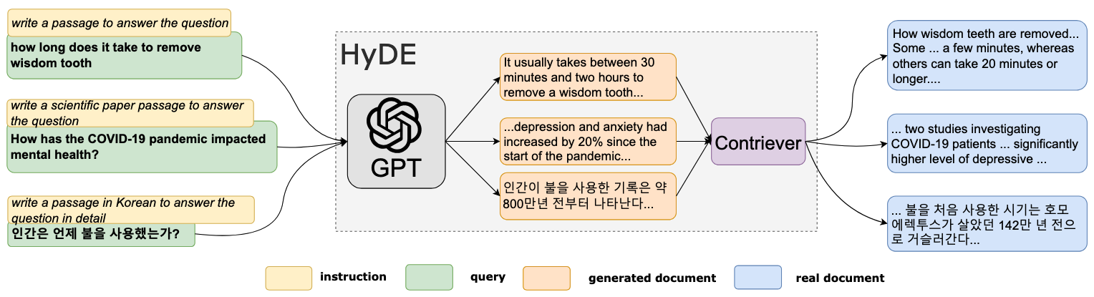
Hypothetical Document Embeddings (HyDE)
Use an LLM (InstructGPT) to perform query transformations by asking the LLM to write a passage (similar to Query Rewriting).
Gao, Luyu, et al. "Precise Zero-Shot Dense Retrieval without Relevance Labels." ACL 2023.

Slide 54
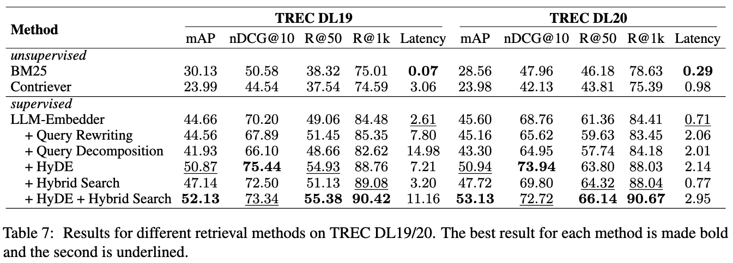
HyDE can be better than Query Rewriting for retrieval tasks
Wang, Xiaohua, et al. "Searching for best practices in retrieval-augmented generation.” EMNLP 2024.

Slide 55
Recent RAG Developments
Type | Method | Paper | Venue Year
Enhancing Retrieval | Query Rewriting | Query Rewriting in Retrieval-Augmented Large Language Models | EMNLP 2023
 | HyDE | Precise Zero-Shot Dense Retrieval without Relevance Labels | ACL 2023
Enhancing RAG | RetRobust | Making Retrieval-Augmented Language Models Robust to Irrelevant Context | ICLR 2024
 | RAFT | RAFT: Adapting Language Model to Domain Specific RAG | COLM 2024
 | Self-RAG | Self-RAG: Learning to Retrieve, Generate, and Critique through Self-Reflection | ICLR 2024
 | RAAT | Enhancing Noise Robustness of Retrieval-Augmented Language Models with Adaptive Adversarial Training | ACL 2024
Enhancing RAG with Continual Retrieval | FLARE | Active Retrieval Augmented Generation | EMNLP 2023

Slide 56
Thank you!
Instructor: 林英嘉
✉️ yjlin@cgu.edu.tw
TA: 吳宣毅
✉️ m1161007@cgu.edu.tw

